Slide 1
KAVIKULGURU INSTITUTE OF TECHNOLOGY AND SCIENCE
RAMTEK – 441 106
DESIGN AND IMPLEMENTATION OF AN ONLINE PAYMENT
SYSTEM USING FACE RECOGNITION TECHNIQUE
by
Ms. Samiksha Zade (CT15007)
Mr. Nikhil Nagpure (CT15043)
Mr. Rishi Kumar (CT15113)
Mr. Bhupender Yadav (CT15115)
Under the guidance of
Mr. K. Nagaraju
Assistant Professor
2018-19
DEPARTMENT OF COMPUTER TECHNOLOGY

Slide 2
Topics
Introduction
Why Face recognition?
How Face recognition work?
Working of Face Payment System
Things that Face recognition can do
Available Applications
Problem to cope
References

Slide 3

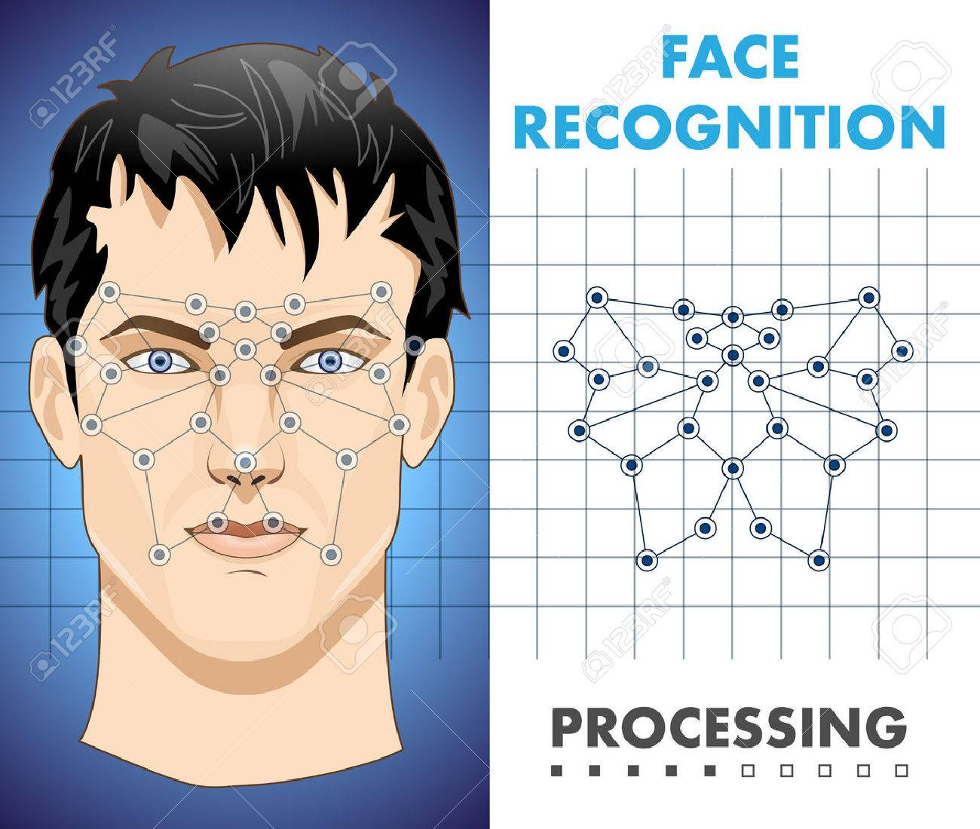
INTRODUCTION
What is Face recognition?
Face recognition aims to detect faces in still image and sequence image from video.
Human face recognition procedure basically consists of two phases.
Face Detection Face Recognition

Slide 4
Problem Statement
Given an image or a sequence of images of a scene, identify or authenticate one or more people in the scene
1. automatically locate the face
2. recognize the face from a general view point under different illumination conditions, facial expressions, facial accessories, aging effects, etc.
3. to implement online payment system.

Slide 5
Project Background – Why Face?
KEY PURPOSE
Biometric security specialists.
Iris, fingerprint, signature, 2D face.
New product: 3D facial recognition.
Growing Interest in biometric authentication
National ID cards, Airport security, Surveillance.
Non-intrusive.
Can even be used without subjects knowledge.
Human readable media.
No association with crime, as with fingerprints.
Data required is easily obtained and readily available.

Slide 6
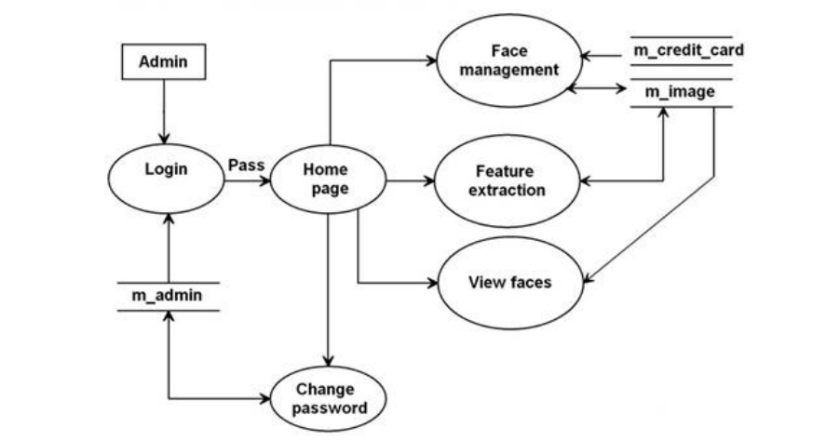
Payment System Flow Chart for Administrator

Slide 7
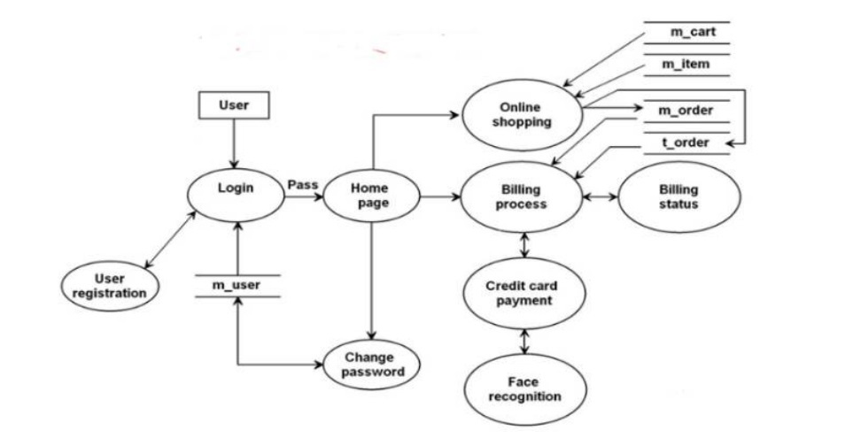
Payment System Flow Chart for Customer

Slide 8
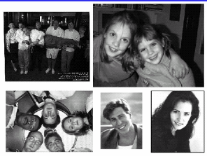
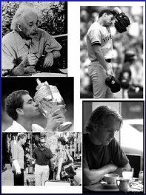
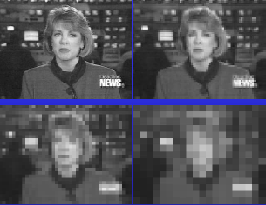
What is Face Detection?
Given an image, tell whether there is any human face, if there is, where is it(or where they are).

Slide 9
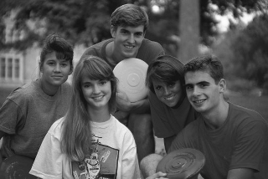
Object Detection
Task
Given an input image,
determine if there are
objects of a given class (e.g.
faces, people, cars..)
in the image and where they are located.

Slide 10
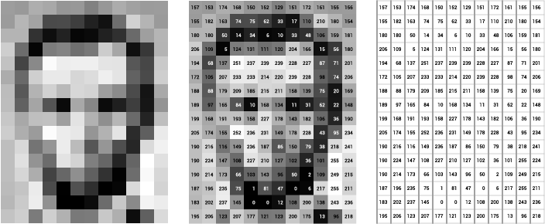
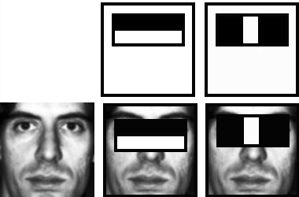
Feature Extraction
Haar Feature
Using features has benefit in training data because that encode critical domain knowledge.
The way these features are used involves computation of difference between the sum of intensities of the pixels in light and dark regions.
Value = PB (pixels in black area) – PW (pixels in white area)
The above step is a key operation as it is repeated a number of times with regions of varying sizes and coordinates. Therefore, it certainly needs to be efficient to achieve overall efficiency.

Slide 11
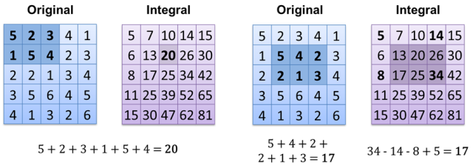
Integral Image
What is an Integral Image representation…?
An intermediate representation which allows us to quickly compute intensities of an area independently of the size of the region with a computational complexity of O(1) instead of O(n)
The value of the integral image at a point is the sum of all the pixels above and to the left.
The sum of the pixels within a rectangle can be computed with four array references.

Slide 12
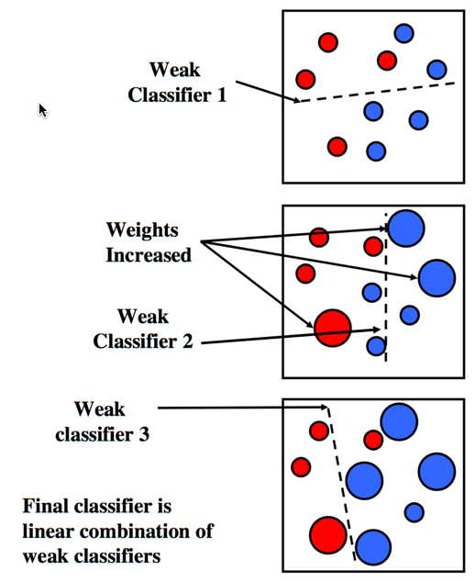
AdaBoost
Adaptive Boosting is a learning algorithm which is used to boost the performance of a simple classifier.
The training data ( a collection of positive and negative samples i.e. the images with and without a human face ) is fed into a weak classifier.
After the first round of learning, the weights are normalized for the examples ( training data images ) to emphasize on those which were incorrectly classified by the previous classifier.
This process is repeated until we get the required accuracy of the classifier.
The final result is a strong classifier which is a linear combination of a number of weighted weak classifiers followed by a threshold.

Slide 13
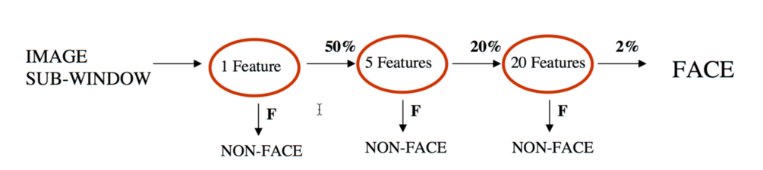
CASCADING
THE ATTENTIONAL CASCADE
The key insight is that smaller ( and therefore more efficient ) boosted classifiers can be constructed which reject many of the negative sub-windows while detecting almost all positive instances.
The idea is to use simpler classifiers to reject a majority of negative sub-windows thereby focussing the attention to only the promising regions of the image.
The end result is an overall efficiency due to the reduction in input sub-windows for the computationally expensive classifiers.

Slide 14


Face Detection – basic scheme
Face examples
Classification Result
Off-line training
Classifier
Feature vector (x₁, x₂ ,…, x_{n})
Feature Extraction
Non-face examples
Pixel pattern
Search for faces at
different resolutions and locations

Slide 15
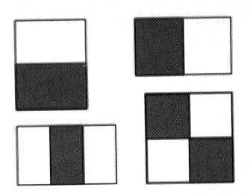
AdaBoost-based Methods
Haar-like features
Viola and Jones propose four basic types of scalar features for face detection as shown in figure. Such a block feature is located in a subregion of a subwindow and varies in shape (aspect ratio), size and location inside the subwindow.
For a subwindow of size 20 × 20, there can be tens of thousands of such features for varying shapes, sizes and locations. Feature k, taking a scalar value z_{k}(x) Є R, can be considered a transform from the n-dimensional space to the real line. These scalar numbers form an overcomplete feature set for the intrinsically low- dimensional face pattern.
Recently, extended sets of such features have been proposed for dealing with out-of-plan head rotation and for in-plane head rotation.
These Haar-like features are interesting for two reasons:
powerful face/nonface classifiers can be constructed based on these features
they can be computed efficiently using the summed-area table or integral image technique.
Four types of rectangular Haar wavelet-like features. A feature is a scalar calculated by summing up the pixels in the white region and subtracting those in the dark region.

Slide 16


Face detection and recognition
Detection
Recognition
NIKHIL
Notes:
16

Slide 17
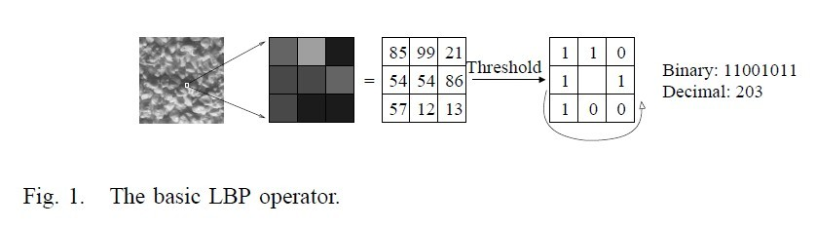
Basic LBP operator
The histogram of the labels used as a texture descriptor.
The LBP operator was originally designed for texture description. The operator assigns a label to every pixel of an image by thresholding the 3x3-neighborhood of each pixel with the center pixel value and considering the result as a binary number.

Slide 18
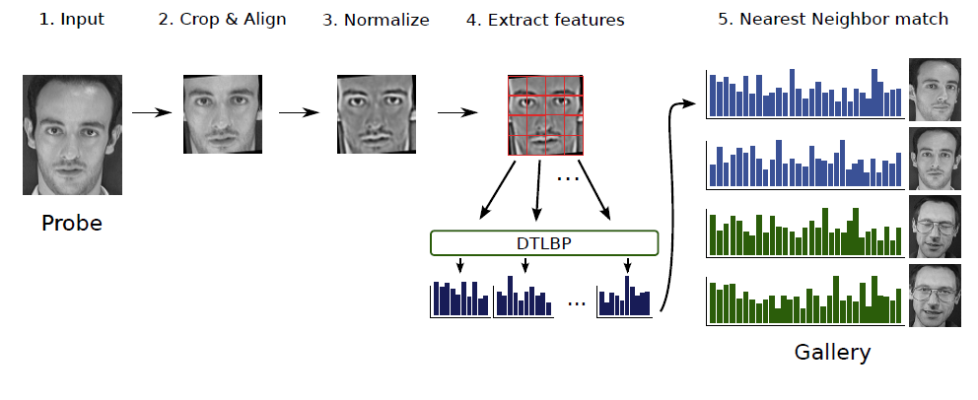
Face Recognition with LBP
Face Recognition with Decision Tree-based Local Binary Patterns

Slide 19


SCREENSHOT OF APPLICATION

Slide 20
Problems to cope
Privacy
Presence of eyeglasses
Variations in skin color under different lighting conditions
Different face angles with respect to the camera
Clarity of the face image, distance from the camera
Different facial expressions (e.g., varying levels of smile)
Hats, caps, or hairstyles that may partially cover the face

Slide 21
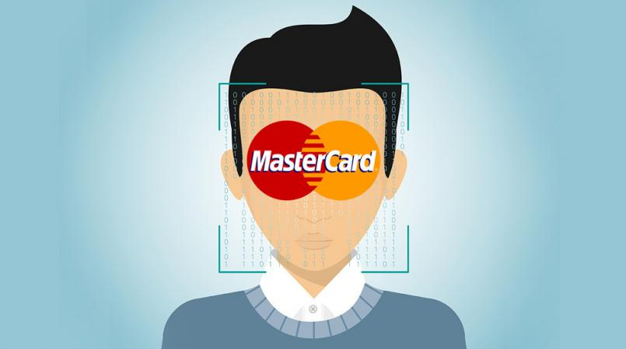
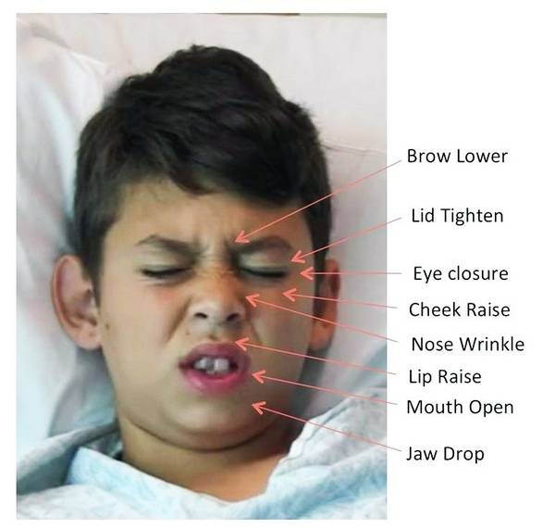
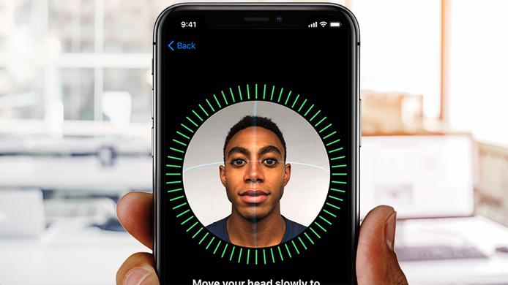
Available Application
Payments
Access and security
Criminal identification
Advertising
Healthcare
Vending Machine
Phone Unlocking
Photo Tagging
Many more

Slide 22
References
Lin S.: ‘An introduction to Face Recognition Technology', Informing Science, 2000, 3, pp.1‐6.
An, L., Kafai, M., Bhanu, B.: ‘Dynamic Bayesian network for unconstrained face recognition in surveillance camera networks', IEEE J. Emerg. Sel. Top. Circuits Syst., 2013, 3, (2), pp. 155–164.
Philips, P. J., Moon H., Rauss P., Rizivi S.: ‘The FERET September 1996 Database and Evaluation Procedure', Audio‐ and Video‐based Biometric Person Authentication, Lecture Notes in Computer Science, vol. 1206, 395‐402, Springer 1997.
Liao, S., Lei, Z., Yi, D., Li, S.: ‘A benchmark study of large‐scale unconstrained face recognition'. Int. Joint Conf. on Biometrics (IJCB 2014), Florida, USA, 2014, pp. 1–8.
Turk, M., Pentland, A.: ‘Eigenfaces for recognition', J. Cogn. Neurosci., 1991, 3, (1), pp. 71–86.
Bartlett, M.S., Movellan, J.R., Sejnowski, T.J.: ‘Face recognition by independent component analysis', IEEE Trans. Neural Netw., 2002, 13, (6), pp. 1450–1464.
Belhumeur, P.N., Hespanha, J.P., Kriegman, D.J.: ‘Eigenfaces vs. _sherfaces: recognition using class speci_c linear projection', IEEE Trans. Pattern Anal. Mach. Intell., 1997, 19, (7), pp. 711–720.
Hu, H., Zhang, P., De la Torre, F.: ‘Face recognition using enhanced linear discriminant analysis', IET Comput. Vis., 2010, 4, (3), pp. 195–208.

Slide 23
THANK
YOU

